Slide 1
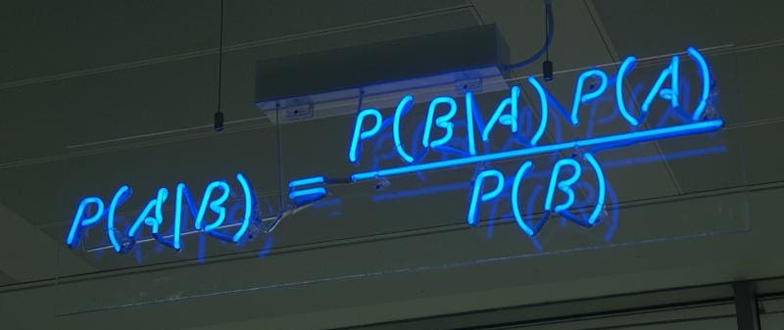
Naïve Bayes Classifier Algorithm

Slide 2
Introduction
Naïve Bayes algorithm is a supervised learning algorithm based on Bayes theorem
used for solving classification problems
Mostly used in text classification that includes a high-dimensional training dataset
probabilistic classifier
egs. spam filtration, Sentimental analysis, and classifying articles

Slide 3
Naïve Bayes Classifier is one of the simple and most effective Classification algorithms
Used for building the fast machine learning models that can make quick predictions

Slide 4
Why is it called Naïve Bayes?
Naïve:
Naive Bayes is called "naive" because it makes a simplifying assumption known as the "naive" assumption:
it assumes that the features (or predictors) in the model are mutually independent given the class.
In real-world data, features often are not completely independent, so this assumption is considered "naive."
Bayes:
It is called Bayes because it depends on the principle of Bayes' Theorem

Slide 5
Bayes' theorem
Bayes' theorem is also known as Bayes' Rule or Bayes' law
Bayes’ Theorem is a simple mathematical formula used for calculating conditional probabilities
Conditional probability is a measure of the probability of an event occurring, given that another event has occurred

Slide 6
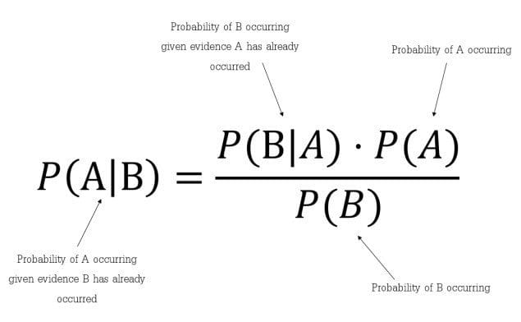

Slide 7
Where,
P(A|B) is Posterior probability: Probability of hypothesis A on the observed event B.
P(B|A) is Likelihood probability: Probability of the evidence given that the probability of a hypothesis is true.
P(A) is Prior Probability: Probability of hypothesis before observing the evidence.
P(B) is Marginal Probability: Probability of Evidence.

Slide 8

Naïve Bayes on Dataset
where, y is class variable and X is a dependent feature vector

Slide 9


Slide 10
Example: Problem: If the weather is sunny, then the Player should play or not?
s.n. | Weather | Play
1 | Rainy | Yes
2 | Sunny | Yes
3 | Overcast | Yes
4 | Overcast | Yes
5 | Sunny | No
6 | Rainy | Yes
7 | Sunny | Yes
8 | Overcast | Yes
9 | Rainy | No
10 | Sunny | No
11 | Sunny | Yes
12 | Rainy | No
13 | Overcast | Yes
14 | Overcast | Yes

Slide 11
Frequency table for the Weather Conditions:
Weather | Yes | No
Overcast | 5 | 0
Rainy | 2 | 2
Sunny | 3 | 2
Total | 10 | 5

Slide 12
Likelihood table weather condition:
Weather | No | Yes
Overcast | 0 | 5 | 5/14 = 0.35
Rainy | 2 | 2 | 4/14 = 0.29
Sunny | 2 | 3 | 5/14 = 0.35
All | 4/14 = 0.29 | 10/14 = 0.29

Slide 13
Applying Bayes'theorem:
P(Yes|Sunny)= P(Sunny|Yes)*P(Yes)/P(Sunny)
P(Sunny|Yes)= 3/10= 0.3
P(Sunny)= 0.35
P(Yes)=0.71
P(Yes|Sunny) = 0.3*0.71/0.35= 0.60

Slide 14
P(No|Sunny)= P(Sunny|No)*P(No)/P(Sunny)
P(Sunny|NO)= 2/4=0.5
P(No)= 0.29
P(Sunny)= 0.35
P(No|Sunny)= 0.5*0.29/0.35 = 0.41

Slide 15
P(No|Sunny)= 0.5*0.29/0.35 = 0.41
P(Yes|Sunny) = 0.3*0.71/0.35= 0.60
So, P(Yes|Sunny)>P(No|Sunny)
From abvove value we can conclude that on a Sunny day, Player can play the game.

Slide 16
Advantages of Naïve Bayes Classifier:
Naïve Bayes is one of the fast and easy ML algorithms to predict a class of datasets.
It can be used for Binary as well as Multi-class Classifications.
It performs well in Multi-class predictions as compared to the other Algorithms.
It is the most popular choice for text classification problems.

Slide 17
Disadvantages of Naïve Bayes Classifier:
Naive Bayes assumes that all features are independent or unrelated, so it cannot learn the relationship between features.

Slide 18
Applications of Naïve Bayes Classifier
It is used for Credit Scoring.
It is used in medical data classification.
It can be used in real-time predictions because Naïve Bayes Classifier is an eager learner.
It is used in Text classification such as Spam filtering and Sentiment analysis.

Slide 19
Types of Naïve Bayes Model:
Gaussian Naive Bayes classifier
The Gaussian model assumes that features follow a normal distribution.
When plotted, it gives a bell shaped curve which is symmetric about the mean of the feature values

Slide 20
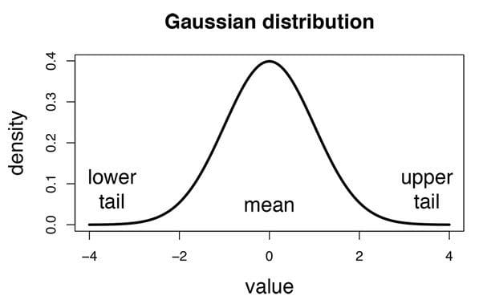

Slide 21
Multinomial Naive Bayes
The Multinomial Naïve Bayes classifier is used when the data is multinomial distributed (there is binomial distribution also)
It is primarily used for document classification problems
The classifier uses the frequency of words for the predictors.

Slide 22
Bernoulli Naive Bayes
features are independent booleans (binary variables)
this model is also popular for document classification tasks

Slide 23
Thank You

